Slide 1

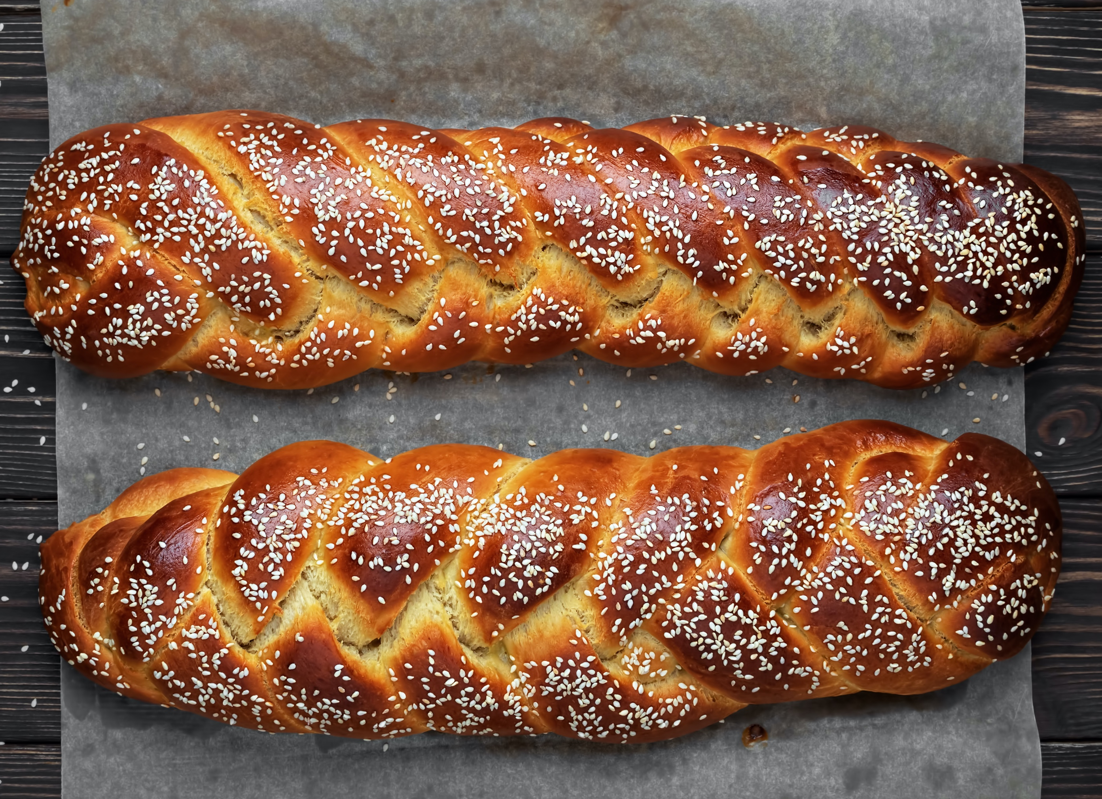



Temple BethEl Sisterhood
Sisterhood News – Jan. 2023
Our programs are open to Temple members, family and friends. Please join us.
Please join us for
Sisterhood
Shabbat
January 21, 2023
Please join us for Shabbat morning service and kiddush, as we celebrate our Sisterhood’s 103rd anniversary.
Kvell, along with our Sisterhood members, and members of Temple Beth Am and Temple Beth David. About three dozen learned women will help lead , and participate in, our service.
We will be joined by Rabbi-Cantor Penny Myers of Buffalo, who will lead the Friday night service, and take a leading role during the Saturday morning service.
P.A.D. Project
Partnering with NCJW, Greater Rochester Section, supporting teens and women in the Rochester area.
.
Wanted: Feminine hygiene products, or dollars.
Drop feminine products in the collection barrel next to the Chapel, or
Send a donation to TBE Sisterhood, 139 Winton Road south, Rochester 14610. Add a note that it’s for P.A.D. We will buy products for you.
Save the Date: Next party to assemble PAD Kits is February 19, 2023, 10 am. Please join us! We need you. It’s fun and it
will only take an hour.
More Community
Service
Food Collection
for the Brighton Food Cupboard.
Wanted: Cereal, Pasta, Pasta Sauce, Rice, Peanut Butter, Tuna, Mayonnaise, Canned Vegetables,
Canned Fruit , Canned Soup , Canned or Boxed Juice, Healthy Snacks
Winter Coat Donation
for Brighton Your Wardrobe.
Wanted: Gently used warm Coats, Gloves, Boots, Hats, children through adult.
Support Sisterhood’s growing portfolio.
Collection containers are near the Chapel.
Bring an item whenever you come to synagogue.
Tikkun Olam
College
“Care Packages”
Do you have a child or grandchild in college this year? Sisterhood would like to send a “care package” to them, to let them know we are thinking about them. We plan to send the packages this winter, prior to Pesach. This program is free and open to Temple Beth El Sisterhood members in good standing.
Please email the following information to Amy at wasscleans@aol.com:
Name of Sisterhood member
Name of college student
College student’s school address
HAPPY (secular) NEW YEAR

Slide 2

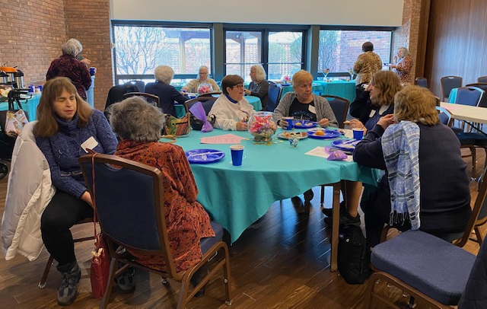
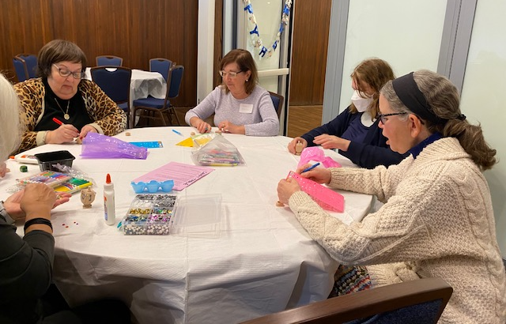
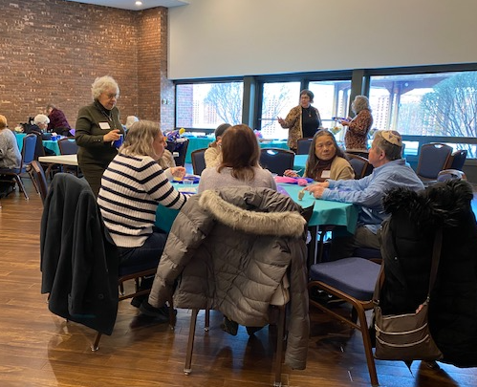
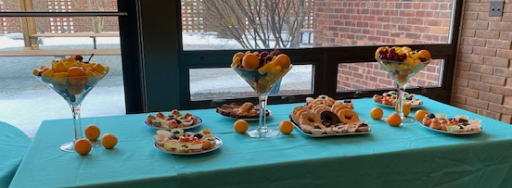

Temple Beth El Sisterhood
More Sisterhood News – Jan. 2023
Mah Jongg
Mondays, 1-3 pm, in the Beit Cafe
Join us for open play each week. Come by yourself or with a partner. Bring your set, if you have one.
Sisterhood Board Meetings
Join the conversation
Sundays at 10 am
Jan 8, Feb 12, Mar 12, April 23
Become more active in Sisterhood.
Want More Info About Sisterhood?
On TBE’s website, click on “Meet”, then “Sisterhood”. Or contact Gail at gailfink49@gmail.com.
DREIDEL TIL YOU DROP
CHANUKAH PARTY
Held Sunday, Dec 18, 2022
The Chanukah party for people who hold Chanukah parties for others!
We enjoyed gourmet food and a fun time. Friendships were renewed, and new ones made.
This was a winner!
It was unanimous – let’s do it again next year.
Many thanks to to our Food Team - Barb Schron, Lana Russ and Judy Schulman. Thanks also to our Program Team – Gail Finkelstein, Amy Wasserman and Sue Greenberg.
Program Report
Just Judaica Gift Shop Open Wed 2-4 pm, and by appointment.
The largest Judaica Gift Shop Call Lynda Axelrod 585-385-3563 or
in Western New York Gail Finkelstein 585-755-8790.

